Slide 1

PRESENTS
CAREER COUNSELLING SEMINARS

Slide 2

Have you heard these before?
“My parents wants me to become a Management graduate, but I want to research. What should I do?”
“I am confused, what do I become so that I am successful?”
“Will I be able to complete my engineering at the small budget that my father has set for my studies?”
“I want to become a Doctor will I be successful?”
“I want to be writer ,but my father wants me to be an engineer like him”
“Amit ,my elder brother is pursuing engineering. But I want to become a pilot.Can I become one?”
“I want to study medicine, but my parents would not allow me to go out of the city. Can you suggest some colleges near my city?”
“My school life is about to end with very dry career options from my Teacher, parents, uncle and aunty. What should I do?”

Slide 3
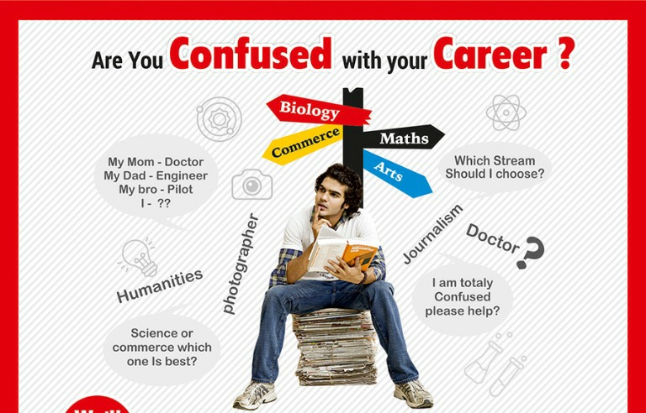

Slide 4
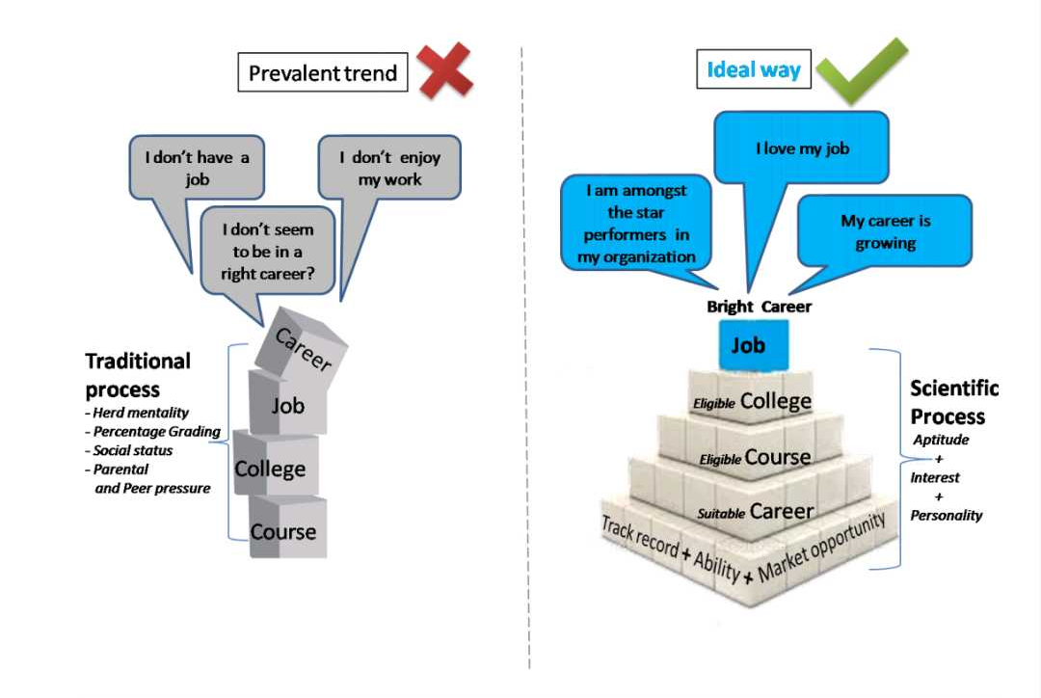
Deciding Your CAREER

Slide 5
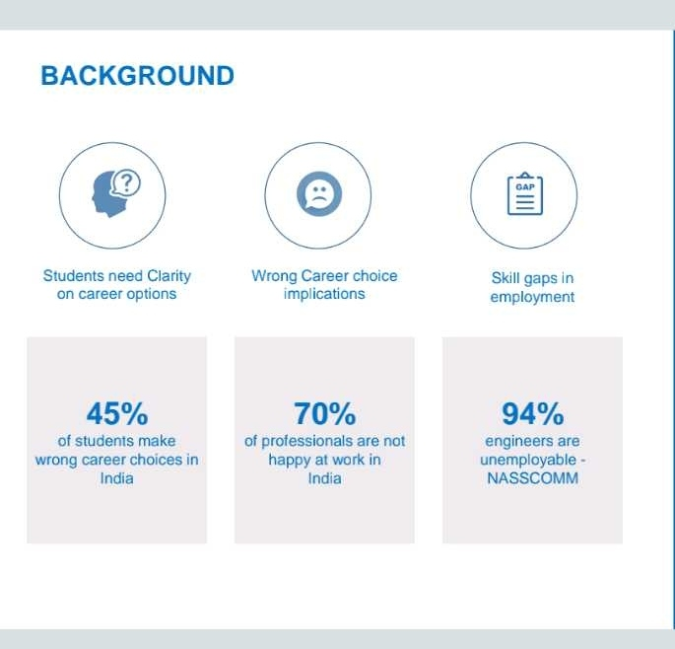
Background

Slide 6
Our MISSION
HELP STUDENTS
Realise their Potentials
Deliver Right Career Guidance through Holistic and Personalised Education

Slide 7
Our UNIQUE Approach
OMNISCAN TECHNOLOGY
Proprietary and Under Patent Process
Scientifically Recommendation Engine does a 360 degree mapping of a students profile on the critical aspects that are required to decide a Career, Course & College

Slide 8
Our UNIQUE Approach
INTROSPECTION TEST
Aptitude Test
Personality Test
Interest Test
Study Habits
Recommended Career

Slide 9
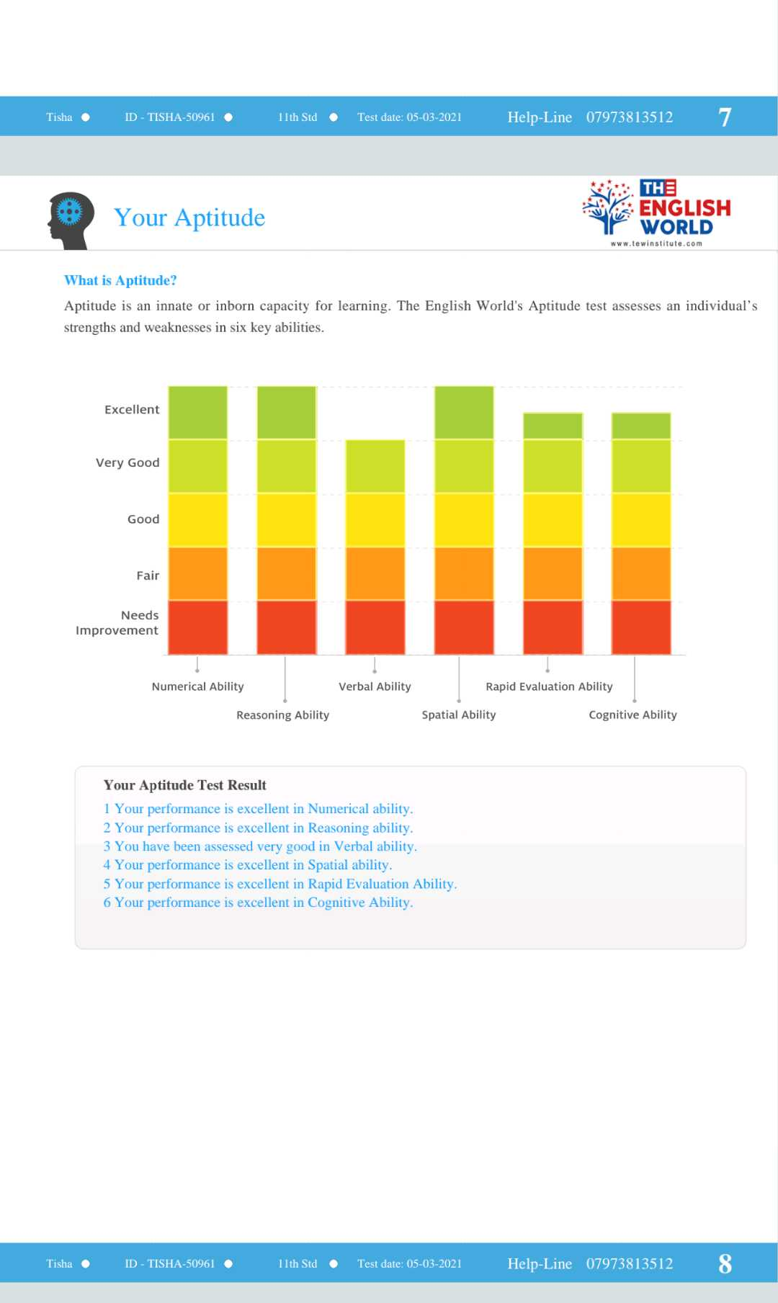
1. Aptitude Test Mapping

Slide 10
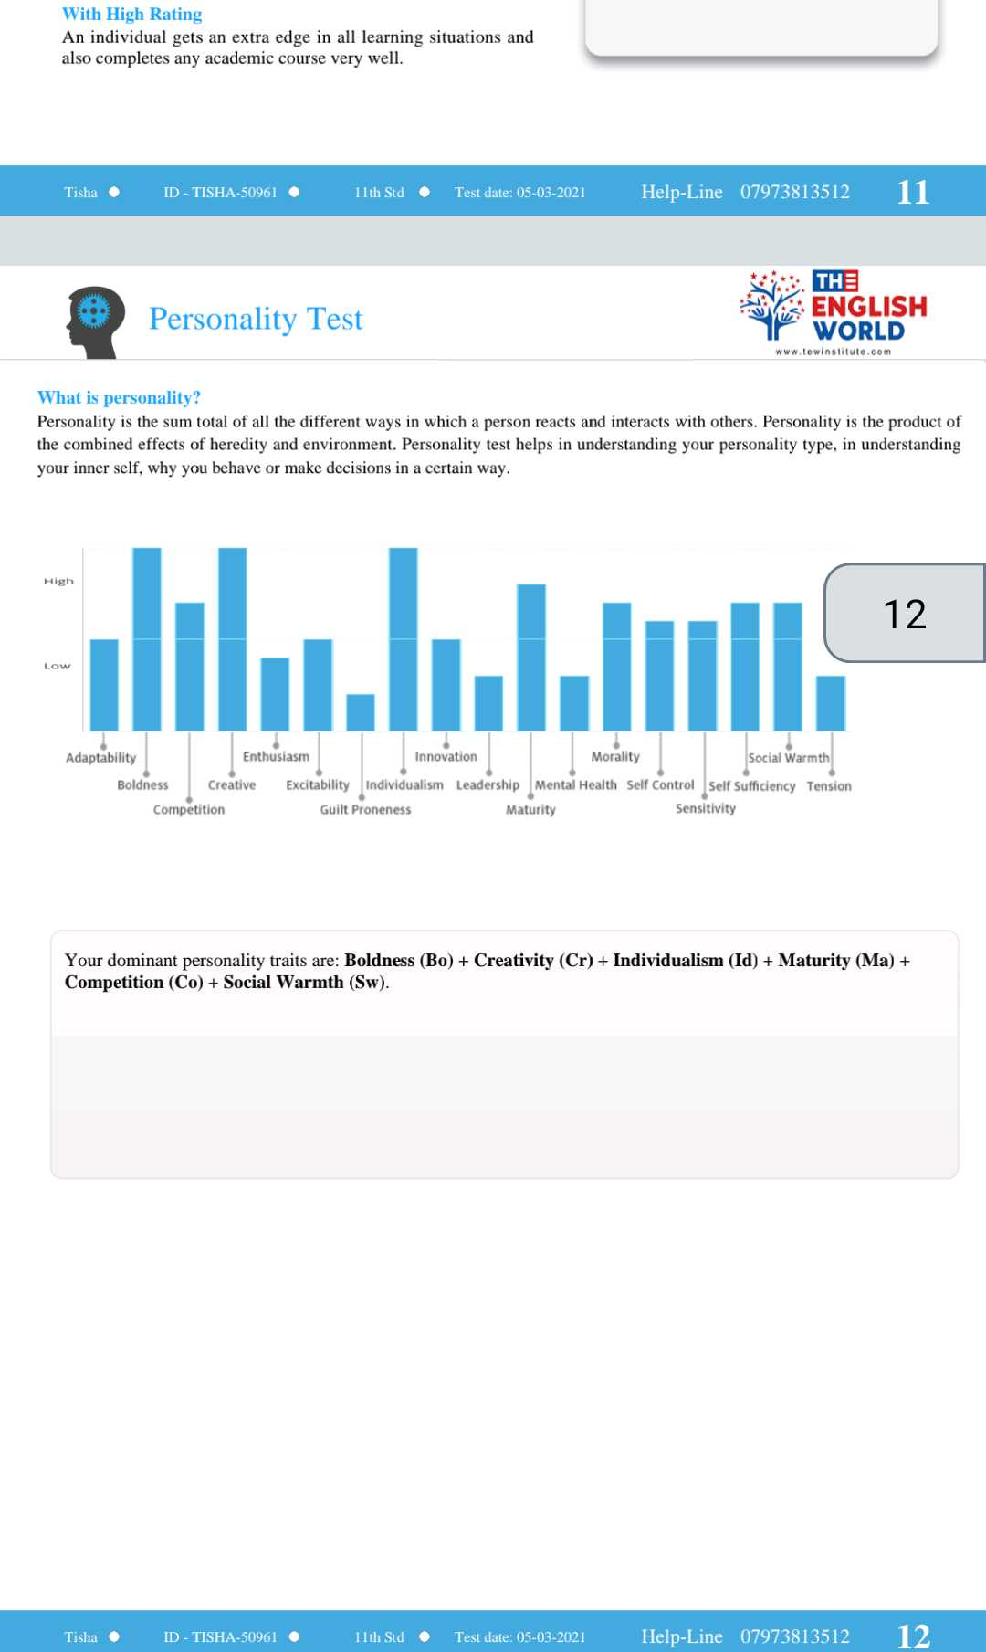
2. Personality Test Mapping

Slide 11
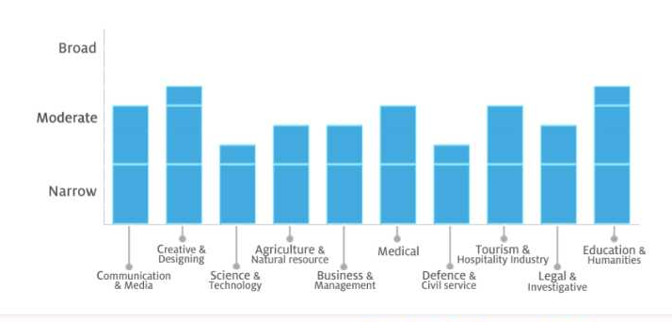
3. Interest Test Mapping

Slide 12
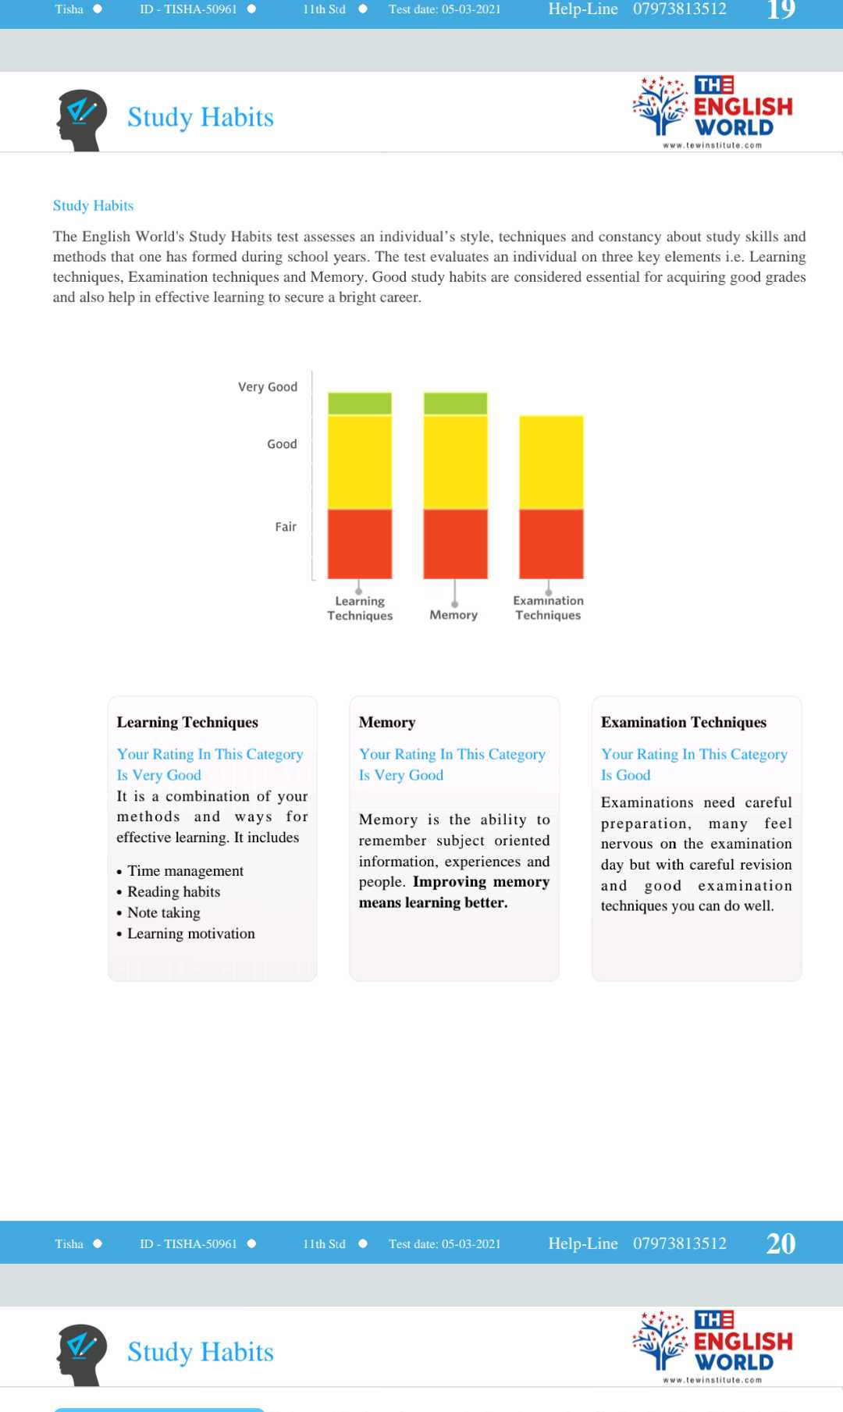
4. Study Habits

Slide 13
WHATEVER YOU decide to do,
MAKE SURE it makes you
Happy!

